Slide 1
Chapter 4
Search in Complex Environments
(Local search and Genetic Algorithms)

Slide 2
Local Search and Optimization Problems
"Local search algorithms use little memory and can find good solutions in large or infinite spaces.“
Local search is a search strategy used in Artificial Intelligence (AI) and optimization where the algorithm starts with a candidate solution and then iteratively moves to a neighboring solution to find a better one — based on a predefined objective or evaluation function.
Key Points
- It doesn’t explore the entire search space.
It doesn't keep track of paths, only the current state.
It’s useful when the solution path is not important, only the final solution matters.
Examples: 8-Queens, circuit layout, scheduling.

Slide 3
Searching algorithms
Comparison of Search Algorithms
Search Algorithm | Search Type (Local / Global)
Depth First Search | Global
Breadth First Search | Global
Hill Climbing | Local
Genetic Algorithm | Global
Best First Search | Global
A* Algorithm | Global
Simulated Annealing | Local
Tabu Search | Local

Slide 4
Hill Climbing Algorithm
Hill Climbing works by iteratively improving a candidate solution until no further improvements can be found.
Initialization: Start from an initial point (solution).
Neighbor Evaluation: Evaluate neighboring solutions to find a better one.
Move: Move to the neighboring solution if it’s better.
Repeat: Continue until no better neighbor exists.

Slide 5
Hill climbing algorithm
Step 1: Evaluate the initial state, if it is goal state then return success and Stop.
Step 2: Loop Until a solution is found or there is no new operator left to apply.
Step 3: Select and apply an operator to the current
state.
Step 4: Check new state:
If it is goal state, then return success and
quit.
Else if it is better than the current state then
assign new state as a current state.
Else if not better than the current state, then
return to step2.
Step 5: Exit.

Slide 6
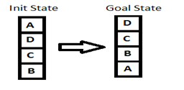
HC Example
Let's define such function h:
h(x) = +1 for all the blocks in the support structure if the block is correctly positioned otherwise -1 for all the blocks in the support structure.
Here, we will call any block correctly positioned if it has the same support structure as the goal state. As per the hill climbing procedure discussed earlier let's look at all the iterations and their heuristics to reach the target state.

Slide 7
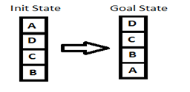
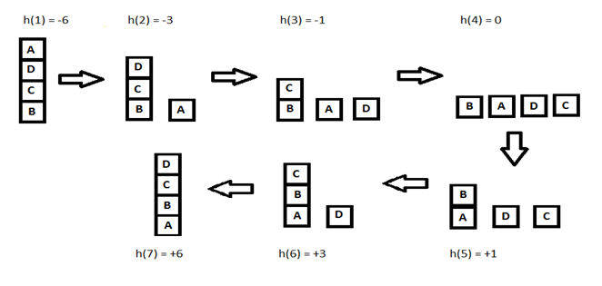
HC Example
Heuristic | A | B | C | D | TOTAL
1 | -3 | 0 | -1 | -2 | -6
2 | 0 | 0 | -1 | -2 | -3
3 | 0 | 0 | -1 | 0 | -1
4 | 0 | 0 | 0 | 0 | 0
5 | 0 | 1 | 0 | 0 | 1
6 | 0 | 1 | 2 | 0 | 3
7 | 0 | 1 | 2 | 3 | 6
For step 4 for example, it can be also A on top C and C on top of B, and D alone. This gives A -2, B 0, C -1, D 0 TOTAL -3. Similarly for other steps.

Slide 8











Slide 9


Hill Climbing Algorithm
Problems in Hill Climbing:
Local Maxima: A state that is better than neighboring states but worse than the global best assuming we are maximizing — the algorithm gets stuck there.
Local Minima: A state that is better than neighboring states but worse than the global best assuming we are minimizing — the algorithm gets stuck there.

Slide 10
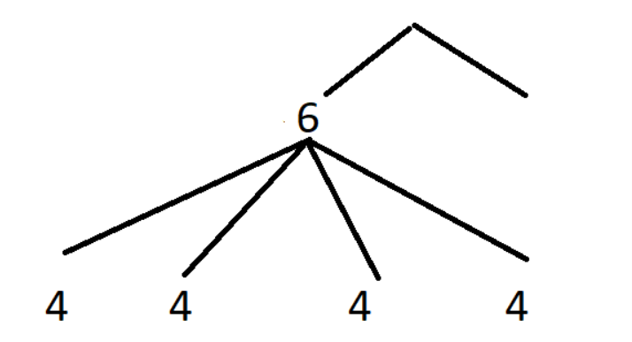
Hill Climbing Algorithm: Problems
Plateau: A flat area where neighboring states have the same value — no direction appears better, leading to random wandering.

Slide 11
Hill Climbing Algorithm: Problems
Local minima
Global Minima
Ridges: Narrow paths that require moving in a direction not aligned with any single action — hard to find using local steps (the last step in ridge is the local Minima).

Slide 12
Hill Climbing Algorithm
Types of Hill Climbing Algorithms:
Simple Hill Climbing
Picks the first better neighbor it finds
Fast, but can miss better options
Steepest-Ascent Hill Climbing
Looks at all neighbors
Chooses the best one
Slower but usually smarter
Stochastic Hill Climbing
Chooses randomly among better neighbors
Adds variety to avoid getting stuck

Slide 13
Hill Climbing Algorithm
Simple Hill Climbing

Slide 14
Hill Climbing Algorithm
Steepest-Ascent Hill Climbing

Slide 15
Hill Climbing Algorithm
Stochastic Hill Climbing

Slide 16
Simulated Annealing
Avoids local maxima by sometimes accepting worse moves.
Probability decreases over time (like cooling metal).
"Simulated annealing allows 'bad' moves to escape local maxima early on."

Slide 17
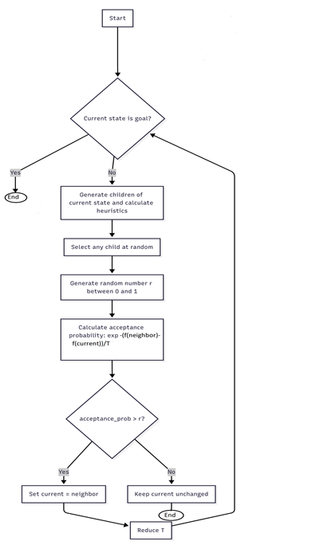
Simulated Annealing
1. If the current state is the goal, finish, or otherwise continue searching.
2. Generate the children of the current state and calculate their heuristics(values).
3. Select any of the children at random.
4. Generate any random number between 0-1.
5. Calculate the acceptance rate based on the following formula (assign a high value for T, say 10):
acceptance_probability = exp(-(f(neighbor) - f(current)) / T)
6. if the acceptance rate is greater than the generated number at random, assign the neighbor/generated node to be current state, otherwise, do not change the current state.
7. Reduce the value of T and go back to step 1

Slide 18
SA example
Example:
acceptance_probability = exp(-(f(neighbor) - f(current)) / T)
(if f(neighbor) < f(current), it is better (we are minimizing))
(if f(neighbor) > f(current)), it is better (we are maximizing)
acceptance_probability = exp(-(f(current) - f(neighbor)) / T)
initial temperature: T = 10 and we are minimizing
If f(neighbor) = 5 and f(current) = 3:
acceptance_probability = exp(-(5 - 3) / 10) ≈ 0.82
This means there's an 82% chance of accepting the neighbor even though it has a higher value.
Later in the algorithm, if T = 1:
acceptance_probability = exp(-(5 - 3) / 1) ≈ 0.14
The chance of accepting a worse solution is now much lower.

Slide 19
Simulated annealing
Note for the acceptance rate:
A value greater than 1 when the neighbor is better (which is not valid as a probability).
A value between 0 and 1 when the neighbor is worse (which is correct).

Slide 20
















Slide 21
Example – 8-Queens Problem
The 8 queens problem is a classic computer science and artificial intelligence puzzle
Definition:
Place 8 queens on a standard 8×8 chessboard such that no two queens attack each other.
This means:
- No two queens are on the same row,
No two queens are on the same column,
No two queens are on the same diagonal.
Goal:Find all possible arrangements (or at least one) that
satisfy the above constraints
8-queens using hill climbing.txt
8-queens.txt

Slide 22
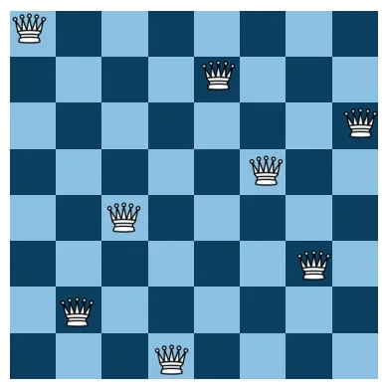

Slide 23
What is Genetic Algorithms
Genetic Algorithms (GA) are search algorithms which are based on the mechanics of selection and natural genetics. They employ the survival of the fittest strategy among string structures with a structural yet randomized information exchange to form a search algorithm with some of the innovative flair of human search.

Slide 24
Genetic Algorithms
phonotype : the characteristics of the genes such as blood color, hair color,….
Allele: The values that can be used for the genes.
Genotype : the combination of alleles such as 00.
Genotype phenotype
00 O
10 or 11 A
20 or 22 B
21 AB

Slide 25
GA
Gas work with a coding of the parameters set, not with the parameters themselves.
Gas are based on the survival of the fittest.
Gas are based on genetic operators.

Slide 26
Genetic Operators
There are three main genetic operators that are well known with Gas. These operators are adopted from biological genetics:
1. Reproduction 2. Crossover 3. Mutation

Slide 27
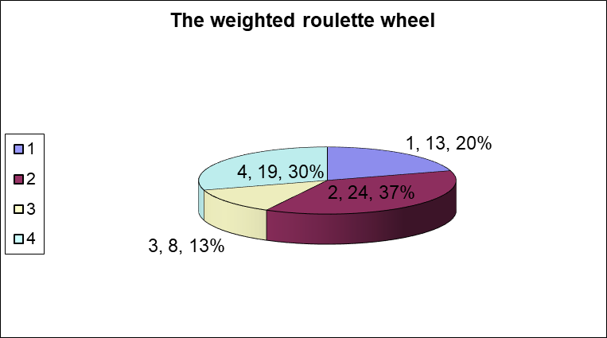
Reproduction
No. | String | Fitness | %of total
1 | 01101 | 13 | 20.3
2 | 11000 | 24 | 37.5
3 | 01000 | 8 | 12.5
4 | 10011 | 19 | 29.7
Total |  | 64 | 100

Slide 28
Crossover
1. Members of the newly reproduced strings in the mating pool are mated at random.
2. Each pair of strings undergoes crossing over, an integer position k along the string is selected at random between 1 and the string length less one, i.e., (1,l-1).
3. Two new strings are created by swapping all characters between position k+1 and L inclusively.
Example
Apply crossover for the given two chromosomes. Assume k=2
A1 = 10 110 A'1 = 10011
A2 = 01 011 A'2 = 01110

Slide 29
Mutation
It simply means changing a 1 to a 0 and vice versa. Certain location within the string is selected at random and flipped.
Example: Apply mutation for the given string assuming that the selected location is 4.
A=10011 → A' = 10001

Slide 30
GA FlowChart

Slide 31
Traveling Sales Problem with GA

Slide 32
TSP-GA Fitness Function
Our objective here is to minimize the total distance of each tour. Hence, it is natural to choose a fitness function to reflect this objective, i.e., the lesser the total distance s, the more the fitness f.
Many functions we can have f=1/s , f=1/s2 or f = k-s, where k is a positive constant that makes f >= 0. The better is the fitness function, the less is the total number of iterations required to find an optimal solution.

Slide 33
TSP-GA Crossover
Crossover operations:
A1 A D E B C A D E E B
A2 A D C E B A D C B C
The ordinary method used for crossover can not be applicable here because many a city can be repeated within the new generation. This means a special method for crossover is to be used.

Slide 34
TSP-GA Crossover

Slide 35
TSP-GA-Crossover

Slide 36
TSP-GA-Crossover + Mutation

